Slide 1
Semantic based Graph Convolutional Neural Network for Entity Extraction
Group Members （sort by first name）:
Haiyang Sun
Hao Zhang
Xuehan Chen
Yanqi Yao
Yirong Wang

Slide 2
Information Extraction
Information Extraction (IE) is the process of extracting structured information from unstructured machine-readable documents
Find and understand limited relevant parts of texts
Gather information from many pieces of text
Produce a structured representation of relevant information:
relations (in the database sense), a.k.a.,
a knowledge base

Slide 3
Named Entity Recognition
Named Entity Recognition (NER) is the process of finding entities (people, cities, organizations, dates, ...) in a text.
Is a subtask under Information Extraction.
Target:
Identify named entities
Classify named entities

Slide 4
The decision by the independent MP Andrew Wilkie to withdraw his support for the minority Labor government sounded dramatic but it should not further threaten its stability. When, after the 2010 election, Wilkie, Rob Oakeshott, Tony Windsor and the Greens agreed to support Labor, they gave just two guarantees: confidence and supply.
The decision by the independent MP Andrew Wilkie to withdraw his support for the minority Labor government sounded dramatic but it should not further threaten its stability. When, after the 2010 election, Wilkie, Rob Oakeshott, Tony Windsor and the Greens agreed to support Labor, they gave just two guarantees: confidence and supply.
A very important sub-task: find and classify names in text, for example:
Person Date Organization

Slide 5
Rule-Based Methods for Entity Extraction
Many real-life extraction tasks can be conveniently handled through a collection of rules, which are either hand-coded or learnt from examples.
Basic rules
Contextual Pattern -> Action
Notes:
A hand-coded system requires human experts to define rules or regular
expressions or program snippets for performing the extraction. That
person needs to be a domain expert and a programmer, and possess
descent linguistic understanding to be able to develop robust extraction
rules.
Rules tend to have the form

Slide 6
Rules to Identify a Single Entity
An example of a pattern for identifying person names of the form “Dr. Yair Weiss” consisting of a title token as listed in a dictionary of titles (containing entries like: “Prof”, “Dr”, “Mr”), a dot, and two capitalized words is
({DictionaryLookup = Titles} {String = “.”} {Orthography type =
capitalized word}{2}) ->Person Names.
Rules for Multiple Entities
Some rules take the form of regular expressions with multiple slots, each representing a different entity so that this rule results in the recognition of multiple entities simultaneously.
({Orthography type = Digit}):Bedrooms ({String =“BR”}) ({}*)
({String =“$”}) ({Orthography type = Number}):Price -> Number
of Bedrooms = :Bedroom, Rent =: Price
Notes:
A basic rule is of the form: “Contextual Pattern ! Action”. A
Contextual Pattern consists of one or more labeled patterns capturing
various properties of one or more entities and the context in which
they appear in the text. A labeled pattern consists of a pattern that is
roughly a regular expression defined over features of tokens in the text
and an optional label. The features can be just about any property of
the token or the context or the document in which the token appears.
The action part of the rule is used to denote various kinds of
tagging actions: assigning an entity label to a sequence of tokens,
or assigning multiple entity tags.
The first term allows the “The” to be optional, the second term matches
all capitalized abbreviations, and the last term matches all capitalized
words that form the last word of any entry in a dictionary of company
names.

Slide 7
Dataset Preprocessing
To feed GCN model and generate the neural network, we must provide three matrices.
N*N matrix represent the dependencies between words in a sentence
N*D matrix represent features of each word
N*E matrix represent class of each word

Slide 8
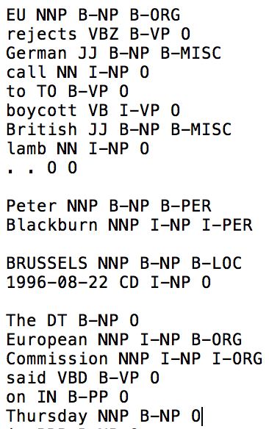
Dataset Preprocessing
EU NNP B-NP B-ORG
EU : word
NNP : part-of-speech (POS) tag
B-NP: syntactic chunk tag
B-ORG: named entity tag
Four types of named entities:
-persons（B-PER）
-locations （B-LOC)
-organizations (B-ORG)
-names of miscellaneous entities that do not belong to the previous three groups (B-MISC)
-not part of a phrase (O)
https://www.clips.uantwerpen.be/conll2003/ner/

Slide 9
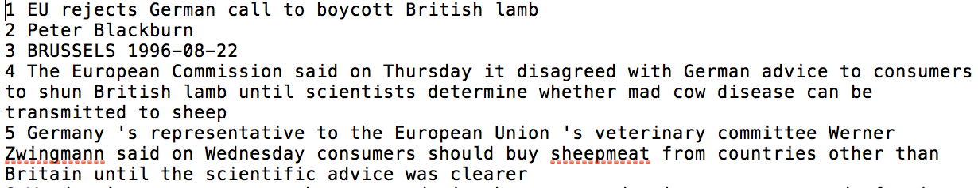
Dataset Preprocessing
CoNLL 2003 dataset provides sentences from newspaper/magazine
Each word are correctly tagged
Use python to get normal sentences from dataset

Slide 10
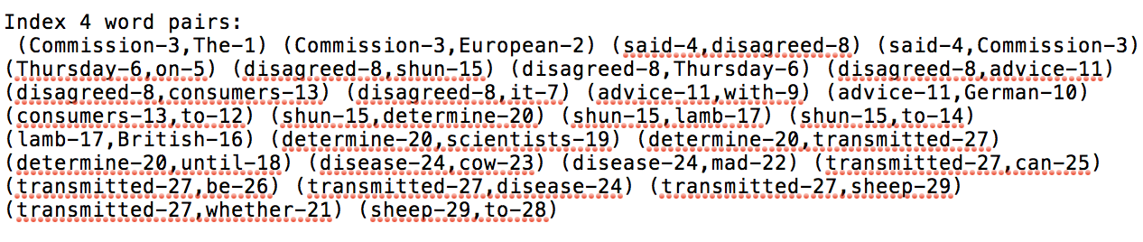
Dataset Preprocessing
With help of Stanford Parser, we write python code to generate every sentence’s dependencies in the dataset
From this generated file we can get dependencies and generate N*N matrix for each sentence
Notes:
There are some dependencies in each sentences, and each dependence has direction, for example: rejects depends on EU.
We create n*n matrix with default value is zero
and based on the dependencies we changed the value in matrix to 1 based on this value.
Eu rejects German call to boycott British lamb.

Slide 11
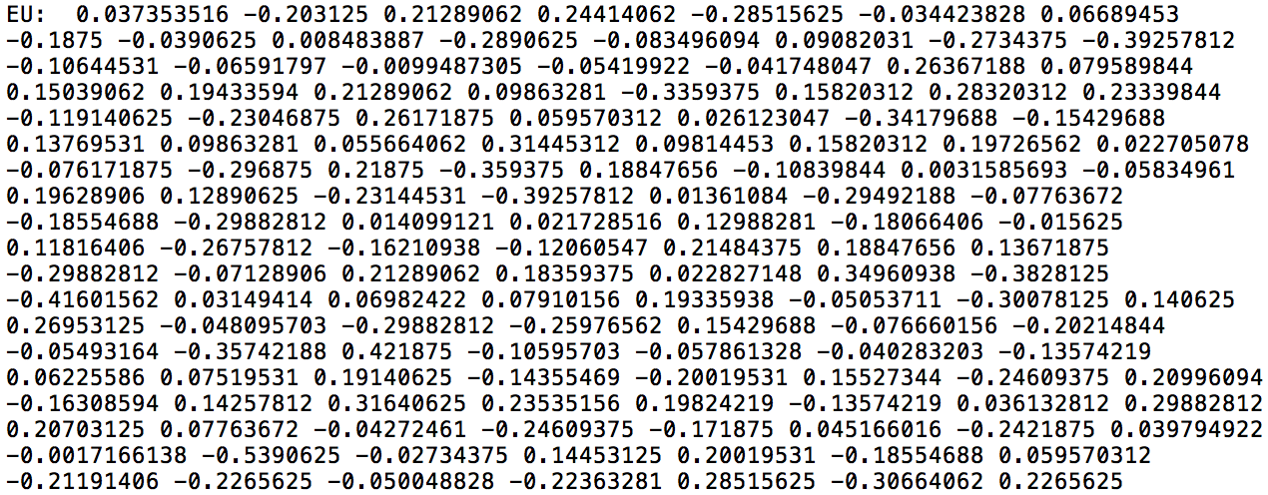
Dataset Preprocessing
We decided to use 300D word2vec to represent a word.
This program is still in debugging…

Slide 12
To do list
Continue to do research on GCN paper
Collect entity information from dataset and generate N*E matrix
Feed three matrices into GCN model, calculate the accuracy
Calculate accuracy/call back rate
Compare accuracy/call back rate with latest paper

Slide 13
Reference
Information Extraction and Named Entity Recognition, Lecture PPT, Stanford
https://web.stanford.edu/class/cs124/lec/Information_Extraction_and_Named_Entity_Recognition.pdf
SEMI-SUPERVISED CLASSIFICATION WITH GRAPH CONVOLUTIONAL NETWORKS https://arxiv.org/pdf/1609.02907.pdf
Convolutional Neural Networks on Graphs with Fast Localized Spectral Filtering https://arxiv.org/pdf/1606.09375.pdf
Graph Convolutional Network https://tkipf.github.io/graph-convolutional-networks/
Information Extraction CIS, LMU München Winter Semester 2015-2016 Dr. Alexander Fraser, CIS http://www.cis.uni-muenchen.de/~fraser/information_extraction_2015_lecture/03_rule_based_NER.pdf

